Slide 1
Internal Presenter Notes: What Attendees Should Take Away
What is Azure Data Factory (ADF)
Transforming data with ADF Mapping Data Flow
Triggering and monitoring ADF

Slide 3
Transforming and enriching data
Speaker name
Title
Notes:
TALKING POINTS
Introductions: Hi, my name is <speaker name> and in this session, Transforming and Enriching data, we are going to walk through how we transform data e using Azure Data Factory.
PRESENTER NOTE: Validate whether all attendees attended DATA20 session, if not, you likely have to spend a bit more time on slides 5,6,7,8, which otherwise will be a refresh.
As a presenter, I encourage you to think about use case scenarios and how they apply to your own, or your customers business problems, and how you see the potential of how you can help providing better insights through Cloud Scale Analytics.
I appreciate and welcome questions <pick your own preference here>:
During my presentation
During the presentation, but realize that not all your questions might be addressed, so might defer you to the Q&A section of this presentation
At the end of the presentation
Transforming and enriching data
Tailwind Trader deals with the core issue of having to connect and relate multiple data sources. In order to be able to prepare the data for reasoning and analysis, data requires transformation and enrichment, and that’s what we will cover in this session.

Slide 4
Resources
Session Resources Hub
aka.ms/DATA30
Session Code on GitHub
aka.ms/DATA30Repo
All Event Session Resources
aka.ms/mymsignitethetour
Notes:
Ok everyone, grab your phones and take a snapshot of this, you’ll be able to get all the resources associated with this session right here. These links contain code, docs and more information on sessions you can attend.​

Slide 5
What is Azure Data Factory?
Notes:
TALKING POINTS
For those that didn’t attend the previous session DATA20, let’s quickly go over what Azure Data Factory is, or let’s refresh real quick if you previously attended.
How many of you have used data ingestion tools previously?
PRESENTER NOTES AND GUIDANCE
Poll your audience, ask them for examples on data ingestion, get conversational on the topic, but don’t spend too much time.

Slide 6
Azure Data Factory
A cloud-based data integration service that allows you to orchestrate and automate
data movement and data transformation.
Notes:
TALKING POINTS
Azure Data Factory is the cloud-based ETL and data integration service that allows you to create data-driven workflows for orchestrating data movement and transforming data at scale.
Using Azure Data Factory, you can create and schedule data-driven workflows (called pipelines) that can ingest data from disparate data stores. You can build complex ETL processes that transform data visually with data flows or by using compute services such as Azure HDInsight Hadoop, Azure Databricks, and Azure SQL Database.
PRESENTER NOTES AND GUIDANCE
In this slide be sure to clarify the word orchestrate. Whilst ADF has the ability to perform data movement and transformation itself, it can also perform this by orchestrating the activities of other Azure compute resources such as HDInsight, Databricks or ML services. It also has the ability to make use of existing SSIS packages that an organization might have. Inform the students that this learning path focusses on the native functionality of ADF version 2 to perform the data movement and transformation.
Refresh yourself with an overview of Azure Data Factory with the following link:
https://docs.microsoft.com/en-gb/learn/modules/evolving-world-of-data/index
Read this content that shows the benefits of the cloud over on premises implementations
https://docs.microsoft.com/en-gb/learn/modules/principles-cloud-computing/index
For basic data storage options, read this:
https://docs.microsoft.com/en-gb/learn/modules/intro-to-data-in-azure/index

Slide 7
Azure Data Factory process
Transform
& Enrich
Connect & Collect
Publish
Monitor
Notes:
TALKING POINTS
<Click>
In a typical process of data ingestion, several steps come into place
The first step is making the connection to your data sources, defining the connection to the source data.
<Click>
By either using native ADF functionality, making call to external compute resource (for example a stored procedure in Azure SQL Database, or to a model in Machine Learning Services), or through the integration of SSIS packages, you can perform transformations that will clean or modify the data. You could also enrich that data which means that you perform an analysis that augments the data or creates new data.
<Click>
After the raw data has been refined into a business-ready consumable form, load the data into Azure Synapse Analytics, Azure SQL Database, Azure CosmosDB, or whichever analytics engine your business users can point to from their business intelligence tools.
<Click>
As ADF will perform a regular schedule of data movement activities, it’s important to get a monitoring solution in place to ensure you keep on top of any errors or issues that may occur in the day to day running of the solution
In this session specifically, we will focus on the Transform and Enrich component as part of an ADF process
PRESENTER NOTES AND GUIDANCE
This information is used to serve as a reminder of information you will need to know to present this slide
Refresh yourself with an overview of Azure Data Factory with the following link:
https://docs.microsoft.com/en-us/azure/data-factory/introduction#how-does-it-work

Slide 8



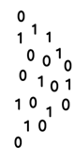



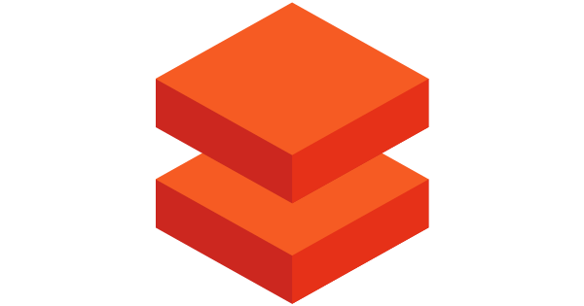
Azure Data Factory Components
@
Triggers
Parameters
Linked Service
IR
Integration
Runtime
CF
Control
Flow
Pipeline
Data Lake Store
1
Activities
Azure Databricks
Dataset
Notes:
TALKING POINTS
Let’s have a closer look at the components of Azure Data Factory
Linked services
Linked services are much like connection strings, which define the connection information that's needed for Data Factory to connect to external resources. Think of it this way: a linked service defines the connection to the data source, and a dataset represents the structure of the data. For example, an Azure Storage-linked service specifies a connection string to connect to the Azure Storage account. Additionally, an Azure blob dataset specifies the blob container and the folder that contains the data.
Linked services are used for two purposes in Data Factory:
To represent a data store that includes, but isn't limited to, an on-premises SQL Server database, Oracle database, file share, or Azure blob storage account. For a list of supported data stores, see the copy activity article.
To represent a compute resource that can host the execution of an activity. For example, the HDInsightHive activity runs on an HDInsight Hadoop cluster. For a list of transformation activities and supported compute environments, see the transform data article.
Datasets
Datasets represent data structures within the data stores, which simply point to or reference the data you want to use in your activities as inputs or outputs.
Activity
Activities represent a processing step in a pipeline. For example, you might use a copy activity to copy data from one data store to another data store. Similarly, you might use a Hive activity, which runs a Hive query on an Azure HDInsight cluster, to transform or analyze your data. Data Factory supports three types of activities: data movement activities, data transformation activities, and control activities.
Pipeline
A data factory might have one or more pipelines. A pipeline is a logical grouping of activities that performs a unit of work. Together, the activities in a pipeline perform a task. For example, a pipeline can contain a group of activities that ingests data from an Azure blob, and then runs a Hive query on an HDInsight cluster to partition the data.
The benefit of this is that the pipeline allows you to manage the activities as a set instead of managing each one individually. The activities in a pipeline can be chained together to operate sequentially, or they can operate independently in parallel.
Triggers
Triggers represent the unit of processing that determines when a pipeline execution needs to be kicked off. There are different types of triggers for different types of events.
Pipeline runs
A pipeline run is an instance of the pipeline execution. Pipeline runs are typically instantiated by passing the arguments to the parameters that are defined in pipelines. The arguments can be passed manually or within the trigger definition.
Parameters
Parameters are key-value pairs of read-only configuration. Parameters are defined in the pipeline. The arguments for the defined parameters are passed during execution from the run context that was created by a trigger or a pipeline that was executed manually. Activities within the pipeline consume the parameter values.
A dataset is a strongly typed parameter and a reusable/referenceable entity. An activity can reference datasets and can consume the properties that are defined in the dataset definition.
A linked service is also a strongly typed parameter that contains the connection information to either a data store or a compute environment. It is also a reusable/referenceable entity.
Control flow
Control flow is an orchestration of pipeline activities that includes chaining activities in a sequence, branching, defining parameters at the pipeline level, and passing arguments while invoking the pipeline on-demand or from a trigger. It also includes custom-state passing and looping containers, that is, For-each iterators.
Variables
Variables can be used inside of pipelines to store temporary values and can also be used in conjunction with parameters to enable passing values between pipelines, data flows, and other activities.
PRESENTER NOTES AND GUIDANCE
This information is used to serve as a reminder of information you will need to know to present this slide
Refresh yourself with an overview of Azure Data Factory with the following link:
https://docs.microsoft.com/en-us/azure/data-factory/introduction#top-level-concepts

Slide 9
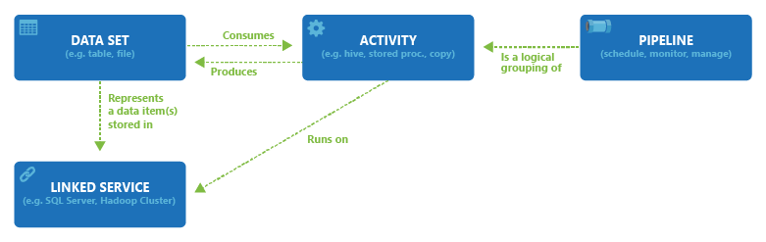
Component dependencies
Notes:
HIDDEN SLIDE
PRESENTER NOTES AND GUIDANCE
This information is used to serve as a reminder of information you will need to know to present this slide
Refresh yourself with an overview of Azure Data Factory with the following link:
https://docs.microsoft.com/en-us/azure/data-factory/concepts-linked-services

Slide 10
Transforming data with the ADF Mapping Data Flow
Notes:
TALKING POINTS
As we described the components of Azure Data Factory, let’s have a closer look on how to perform data transformations with the ADF Mapping Data Flow

Slide 11


Data transformation in Azure
Transforming data with Azure Data Factory
Data preparation
Read data from files using DBFS
Load processed data into tables optimized for analytics
Azure Databricks
Data ingestion
Data storage
Load flat files
into data lake on a schedule
Applications
Load into SQL DW tables
Visualize
Logs, files, and media
(unstructured)
Azure Data Factory
Azure Storage/ Data Lake Store
Azure Synapse Analytics
Power BI
Dashboards
Serving
Business and custom apps (structured)
Applications manage their transactional data directly
Extract and transform relational data
Azure Data Factory
Transform
& Enrich
SQL DB
Transactional storage
Data prep.
Notes:
TALKING POINTS
In this typical architectural diagram, we’ll focus on the data transformation and enrichment of the data process.
PRESENTER NOTES AND GUIDANCE
This information is used to serve as a reminder of information you will need to know to present this slide
Refresh yourself with an overview of Azure Data Factory Mapping Data Flow with the following link:
https://docs.microsoft.com/en-us/azure/data-factory/concepts-data-flow-overview

Slide 12

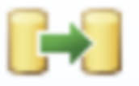
Methods for transforming in Azure Data Factory
Compute resources
SSIS Packages
Mapping Data Flow
Notes:
TALKING POINTS
Azure Data Factory has 3 methods to perform data transformations
PPRESENTER NOTE: this is a build slide
Execute a compute resource You can use ADF to orchestrate the execution of transformation on a compute resources such as Azure Databricks, HDInsight or Azure SQL Server using the native language that the compute resources uses.
Execute existing SSIS package You can leverage existing investments in your data transformations from SSIS packages that you have previously creates as the can be used by ADF
Use the Mapping Data Flow within ADF You can perform transformation using the new Mapping Data Flow capability within Azure Data Factory
PRESENTER NOTES AND GUIDANCE
This information is used to serve as a reminder of information you will need to know to present this slide
Refresh yourself with an overview of Azure Data Factory Mapping Data Flow with the following link:
https://docs.microsoft.com/en-us/azure/data-factory/transform-data

Slide 13
Methods for transforming data in Azure Data Factory
Code free data transformation at scale
Compute resources
SSIS Packages
Mapping Data Flow
Notes:
TALKING POINTS
So let’s dive into the data flow mapping
Mapping data flows are visually designed data transformations in Azure Data Factory. Data flows allow data engineers to develop graphical data transformation logic without writing code. The resulting data flows are executed as activities within Azure Data Factory pipelines that use scaled-out Spark clusters. Data flow activities can be operationalized via existing Data Factory scheduling, control, flow, and monitoring capabilities. Mapping data flows provide a fully visual experience with no coding required. Your data flows will run on your own execution cluster for scaled-out data processing. Azure Data Factory handles all the code translation, path optimization, and execution of your data flow jobs.
PRESENTER NOTES AND GUIDANCE
This information is used to serve as a reminder of information you will need to know to present this slide
Refresh yourself with an overview of Azure Data Factory Mapping Data Flow with the following link:
https://docs.microsoft.com/en-us/azure/data-factory/transform-data

Slide 14
Benefits of Mapping Data Flow
Code free data transformation at scale
Perform data cleansing, transformation, aggregations, etc.
Enables you to build resilient data flows in a code free environment
Enable you to focus on building business logic and data transformation
Underlying infrastructure is provisioned automatically with cloud scale via Spark execution
Mapping Data Flow
Notes:
TALKING POINTS
Data Flow mapping brings the following benefits and capabilities:
- Perform data cleansing, transformation, aggregations, etc.
- Enables you to build resilient data flows in a code free environment
- Enable you to focus on building business logic and data transformation
- Underlying infrastructure is provisioned automatically with cloud scale via Spark execution
PRESENTER NOTES AND GUIDANCE
This information is used to serve as a reminder of information you will need to know to present this slide
Refresh yourself with an overview of Azure Data Factory Mapping Data Flow with the following link:
https://docs.microsoft.com/en-us/azure/data-factory/concepts-data-flow-overview

Slide 15
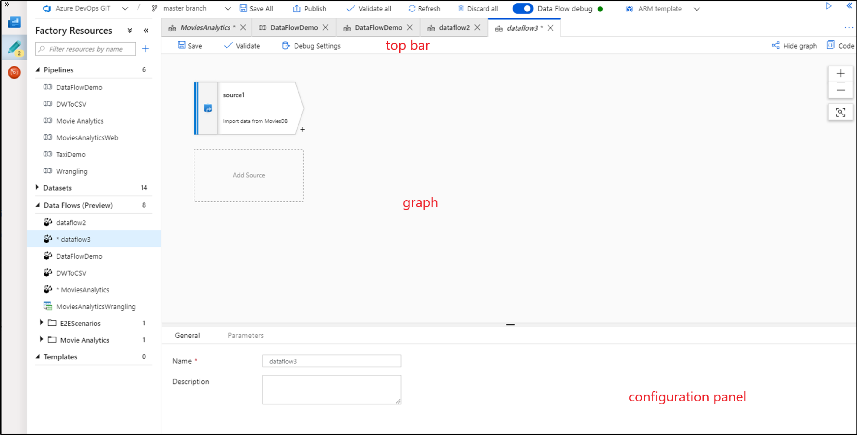
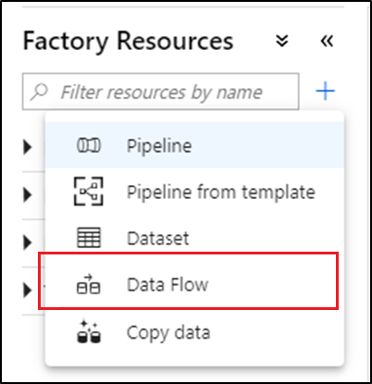
Using the Mapping Data Flow
Code free data transformation at scale
Notes:
TALKING POINTS
Let’s drill down into data flow mappings in Azur Data factory
PRESENTER GUIDANCE: You might want to show this in the azure Portal rather than this slide
To create a data flow, select the plus sign under Factory Resources, and then select Data Flow.
This takes you to the data flow canvas where you can create your transformation logic. Select Add source to start configuring your source transformation. For more information, see Source transformation.
The data flow canvas is separated into three parts: the top bar, the graph, and the configuration panel.
The graph displays the transformation stream. It shows the lineage of source data as it flows into one or more sinks.
The top bar contains actions that affect the whole data flow, like saving and validation. You can also toggle between graph and configuration modes by using the Show Graph and Hide Graph buttons.
The configuration panel enables you to configure the components you add to the graph
PRESENTER NOTES AND GUIDANCE
This information is used to serve as a reminder of information you will need to know to present this slide
Refresh yourself with an overview of Azure Data Factory Mapping Data Flow with the following link:
https://docs.microsoft.com/en-us/azure/data-factory/concepts-data-flow-overview#data-flow-canvas

Slide 16
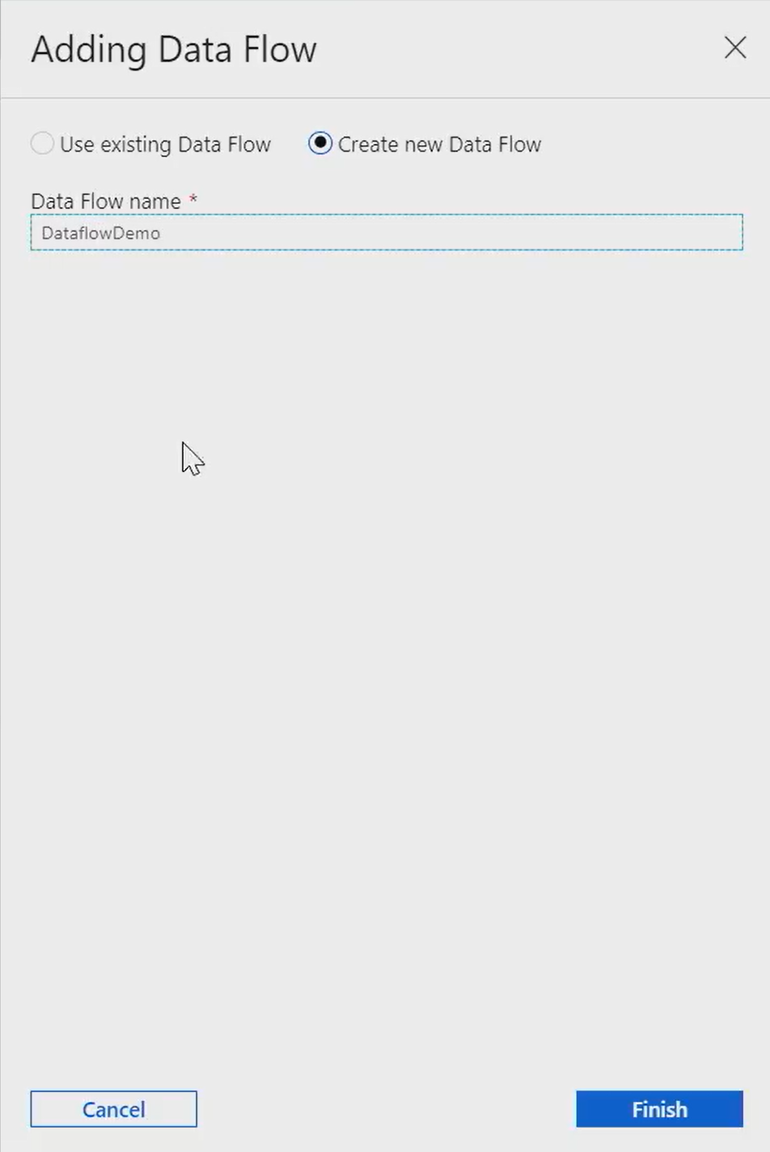
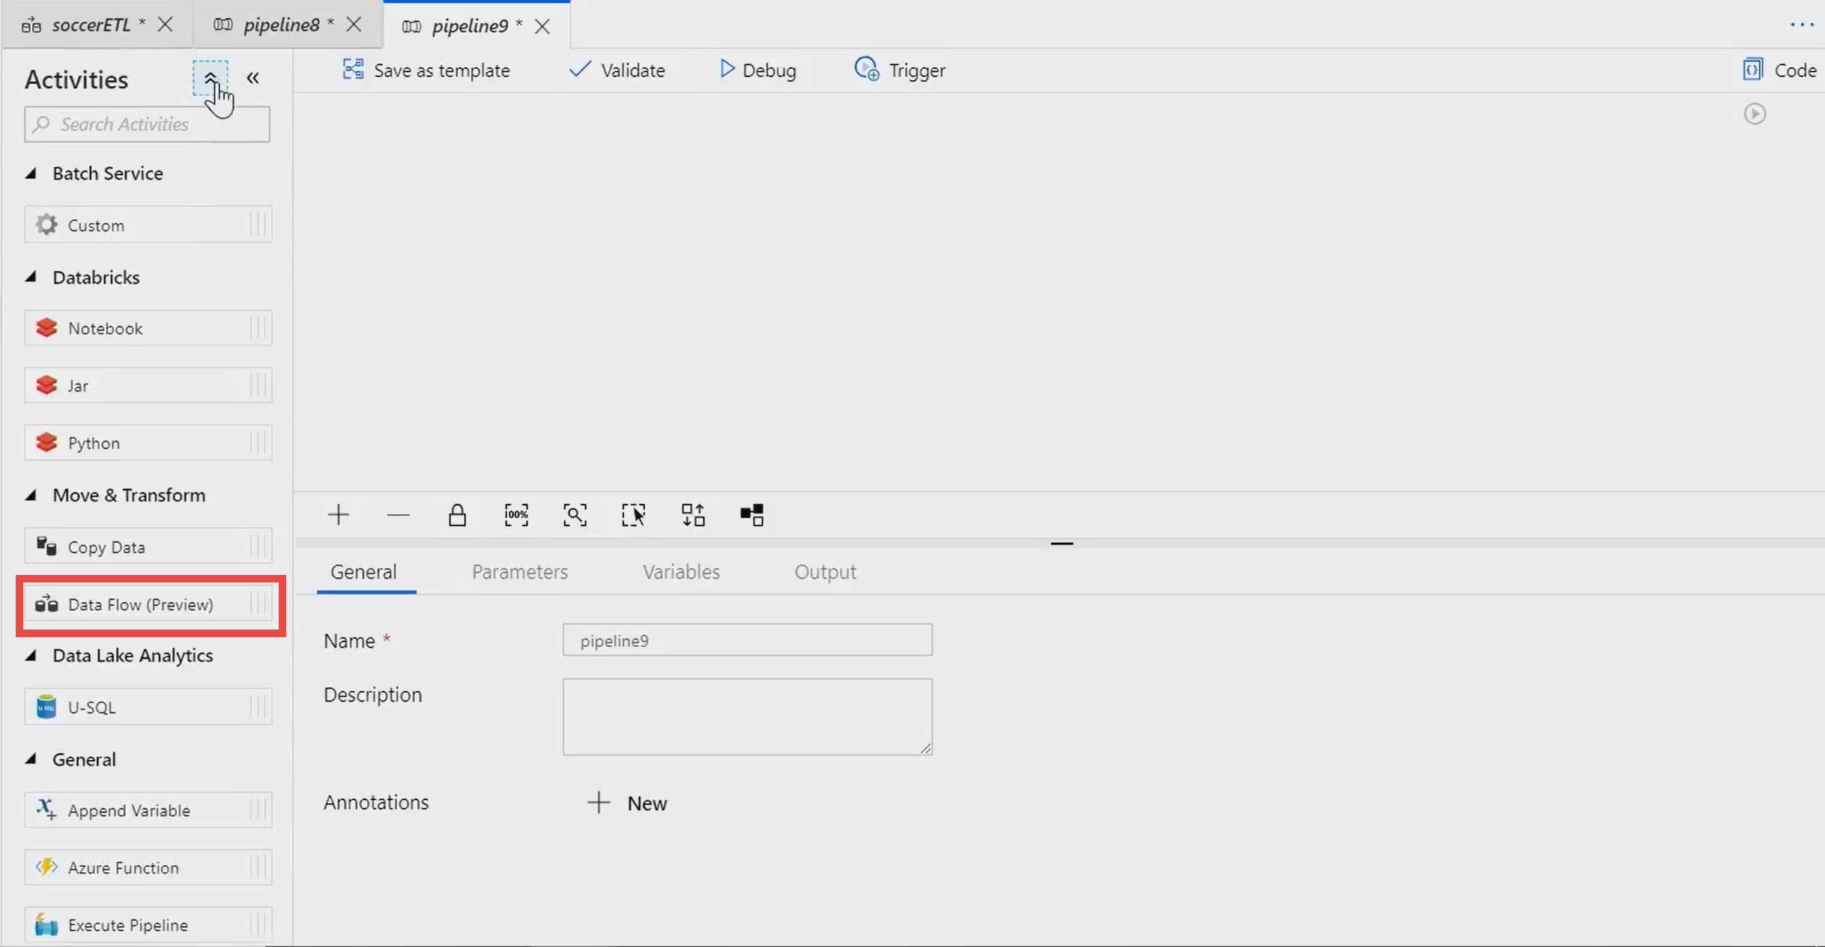
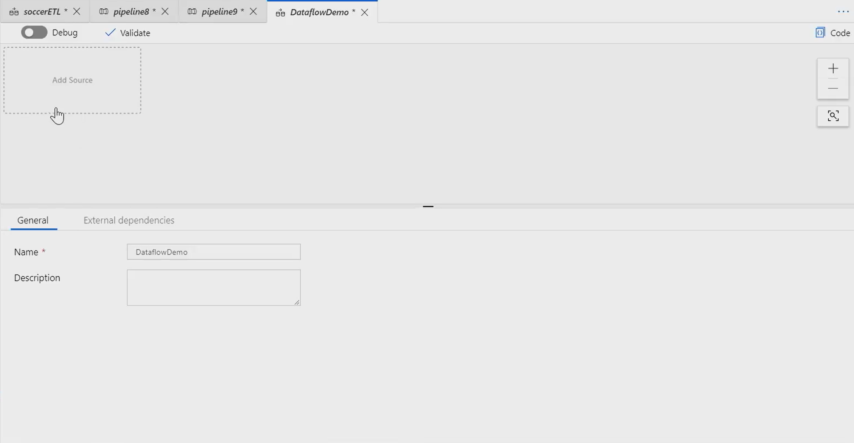
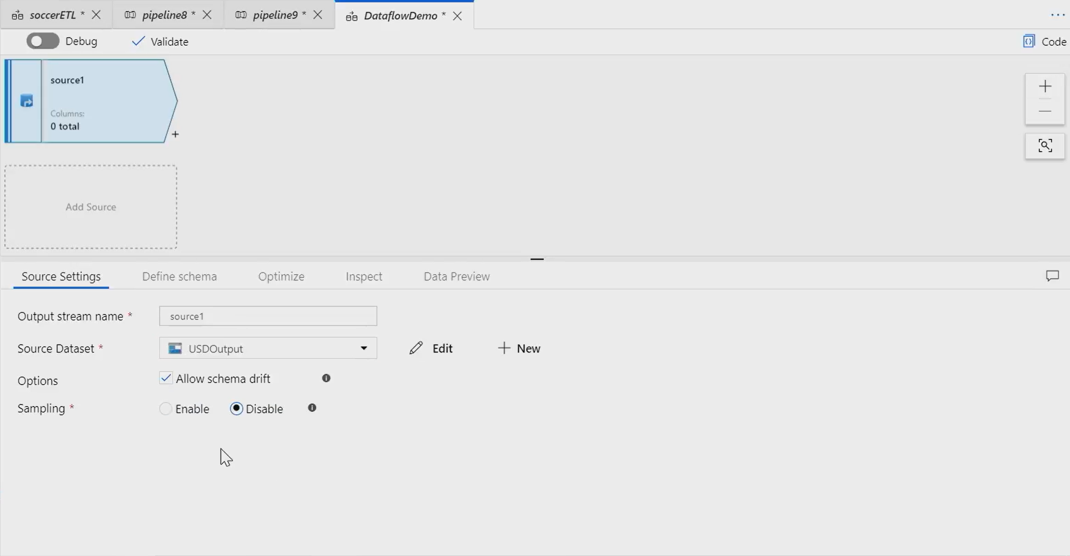

Starting the Mapping Data Flow
Code free data transformation at scale
Notes:
TALKING POINTS
PRESENTER GUIDANCE: You might want to show this in the azure Portal rather than this slide

Slide 17
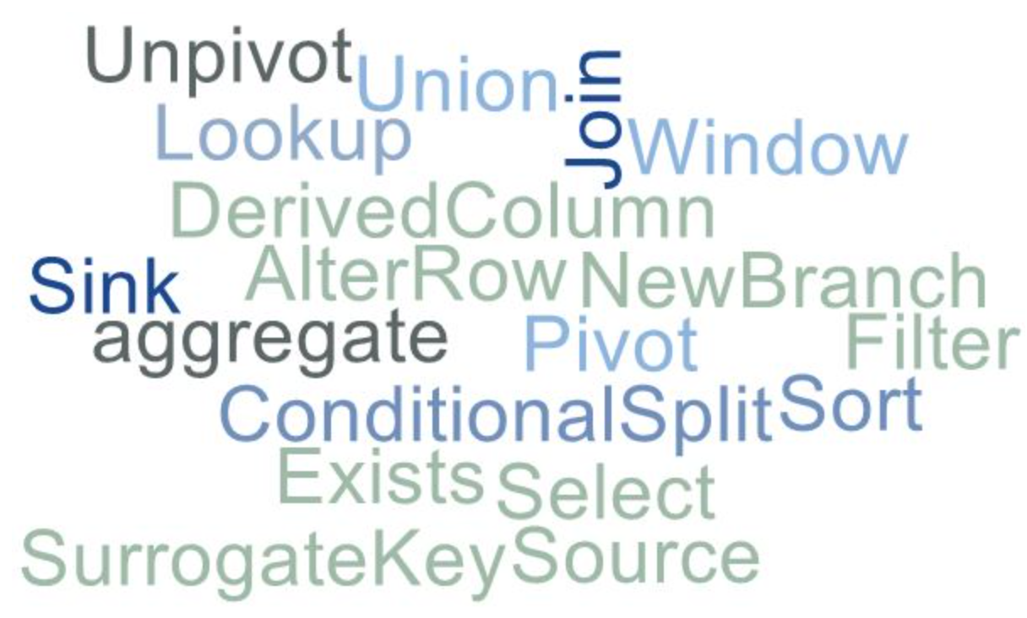
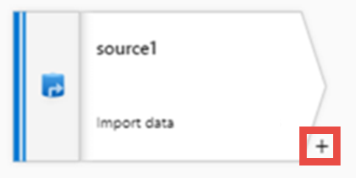
Transformation options in the Mapping Data Flow
Notes:
TALKING POINTS
Like many data transformation tools, Mapping Data Flow in Azure Data factory supports a great variety of data transformations.
In the demo we’ll have a closer look on how to map data transformations
Select transformation
Filter Transformation
Derive Transformation
Window Transformation
Aggregate Transformation
Alter Row Transformation
Adding a transformation is done by clicking on the + symbol
PRESENTER NOTES AND GUIDANCE
This information is used to serve as a reminder of information you will need to know to present this slide
Refresh yourself with the various transformations starting with the aggregate transformation with the following link:
https://docs.microsoft.com/en-us/azure/data-factory/data-flow-aggregate

Slide 18
Triggering and monitoring
Notes:
TALKING POINTS
Triggers
Triggers represent the unit of processing that determines when a pipeline execution needs to be kicked off. There are different types of triggers for different types of events.
While monitor is used to follow the execution of a data pipeline process.
Let’s have a look on how to trigger the Mapping Data Flow

Slide 19
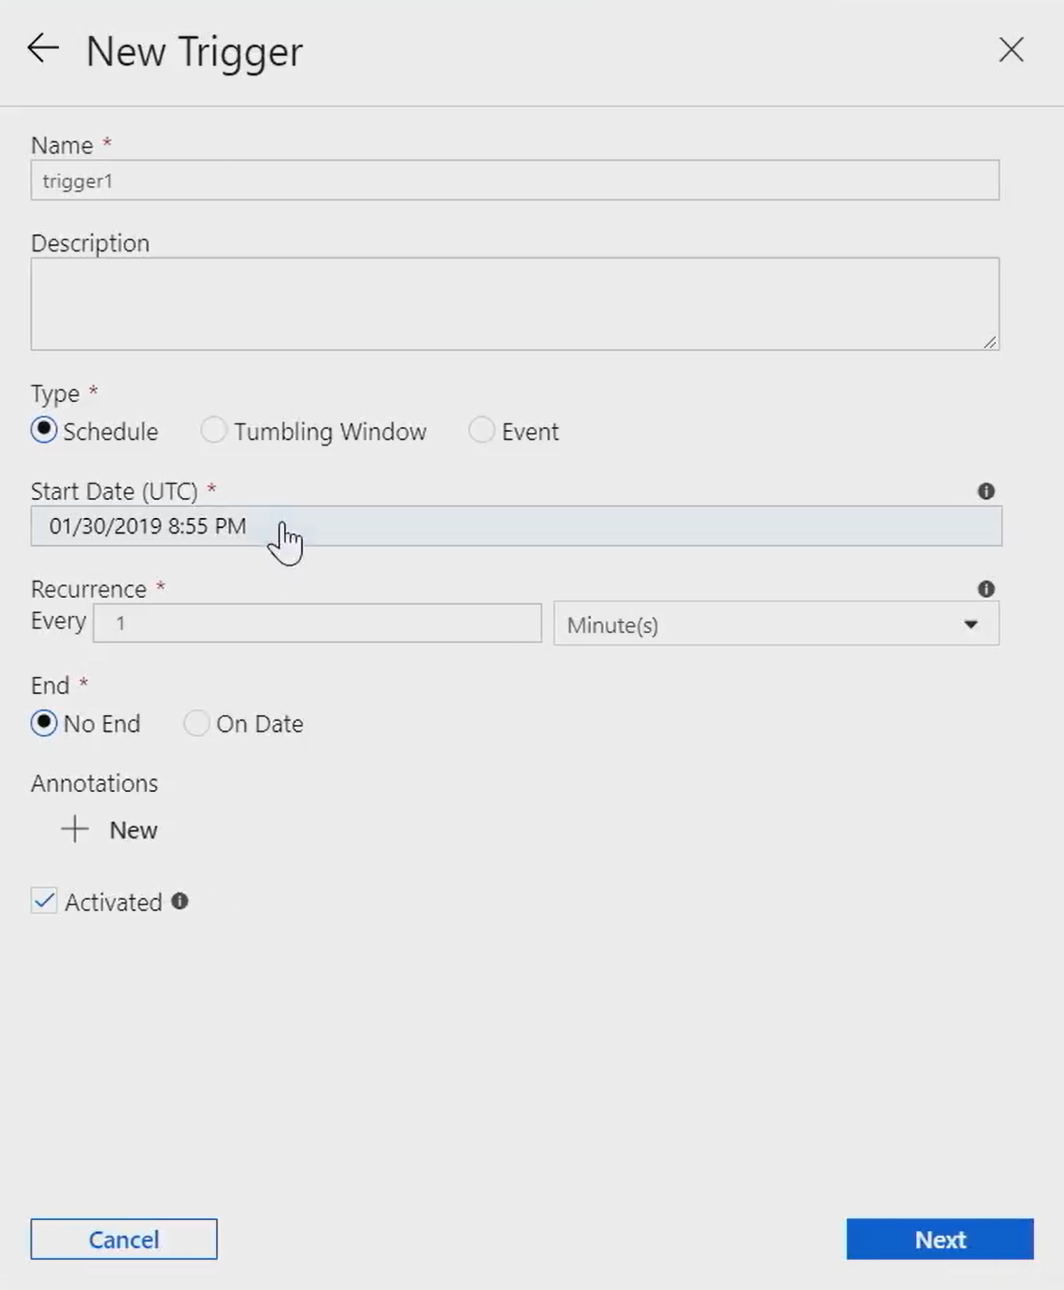
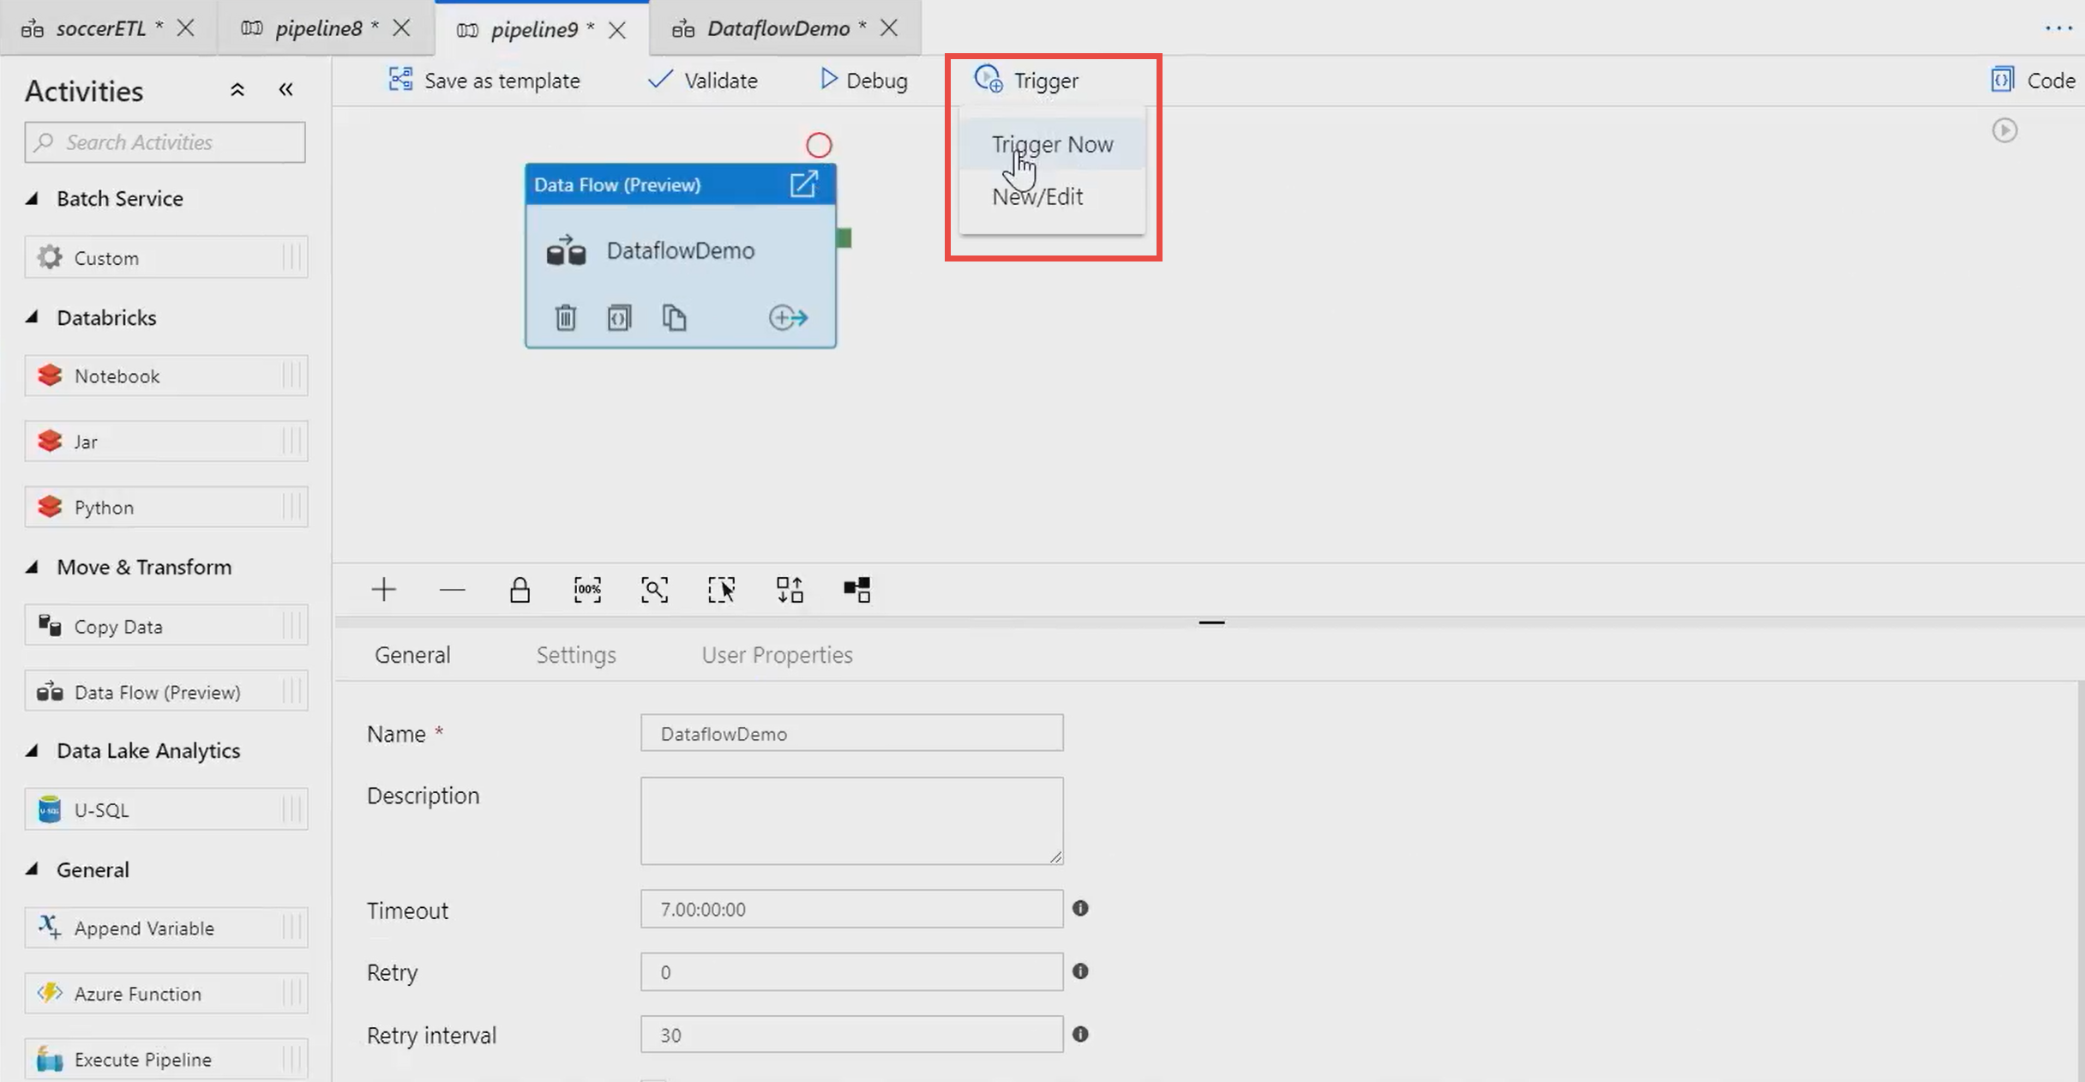
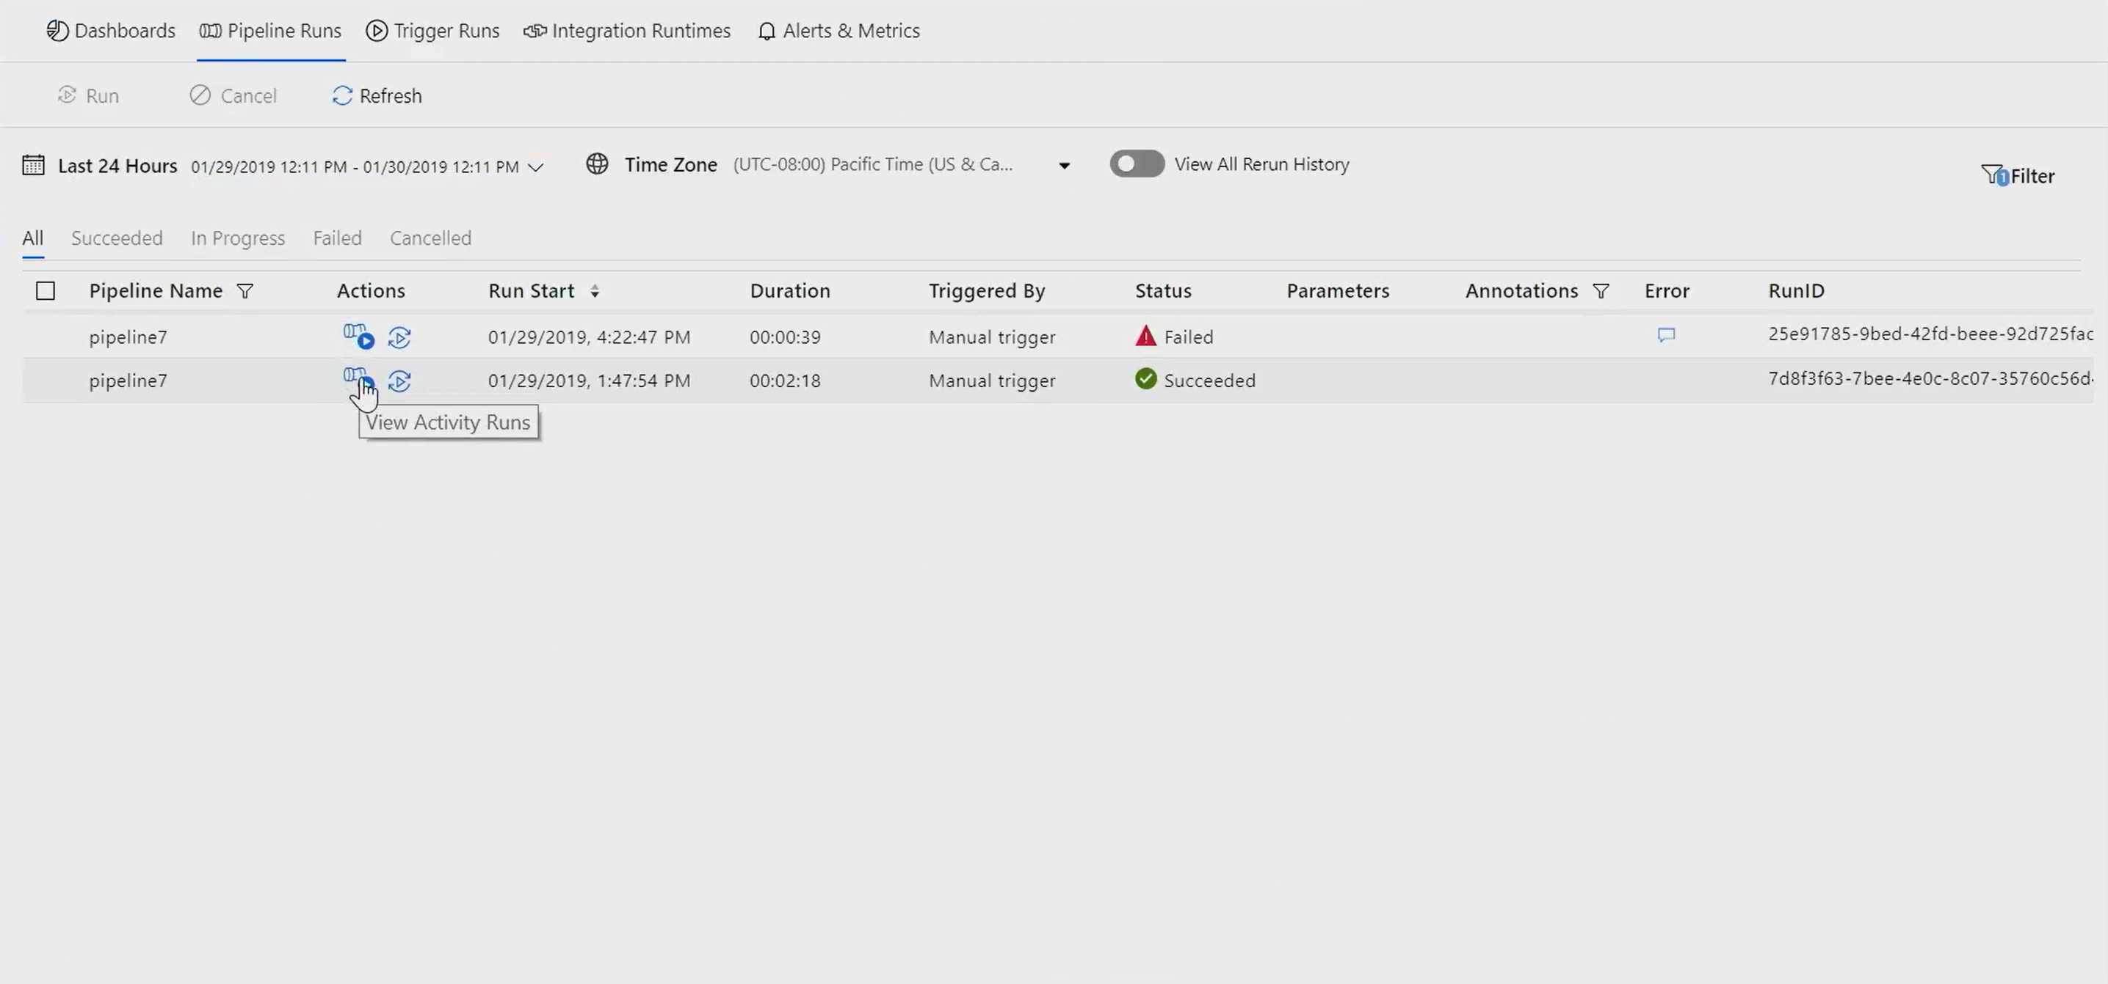
Triggering the Mapping Data Flow
Code free data transformation at scale
Notes:
TALKING POINTS
There’s a variety of methods on how an ADF pipeline can be execute.
Scheduling an event-based trigger is one of the options, but you can also manually trigger.
For the purpose of this session we won’t go into the detail of tumbling window triggers.
PRESENTER NOTES AND GUIDANCE
Refresh yourself pipeline execution triggers with the following link:
https://docs.microsoft.com/en-us/azure/data-factory/concepts-pipeline-execution-triggers
Create a trigger that runs a pipeline on a schedule
https://docs.microsoft.com/en-us/azure/data-factory/how-to-create-schedule-trigger
Create a trigger that runs a pipeline in response to an event
https://docs.microsoft.com/en-us/azure/data-factory/how-to-create-event-trigger
Create a trigger that runs a pipeline on a tumbling window
https://docs.microsoft.com/en-us/azure/data-factory/how-to-create-tumbling-window-trigger
Create a tumbling window trigger dependency
https://docs.microsoft.com/en-us/azure/data-factory/tumbling-window-trigger-dependency

Slide 20
Demo: Transforming your data in Azure Data Factory
Notes:
TALKING POINTS
Let’s bring this all together in our demo
REVIEW THE DETAILED DEMO GUIDE FOR STEPS AND PREREQUISITES

Slide 21

In Summary: Transforming Data with Azure Data Factory
Azure Data Factory (ADF) is a cloud-based data integration service that allows you to orchestrate and automate data movement and data transformation.
Transforming data can be performed in ADF by orchestrating a compute resource, calling an SSIS package or using the Mapping Data Flow feature
The Mapping Data Flow feature enables code free data transformation at scale
Enable you to focus on building business logic and data transformation
It is added to an ADF Pipeline, and can be scheduled or triggered
You can monitor the Mapping Data Flow both visually and programmatically

Slide 22
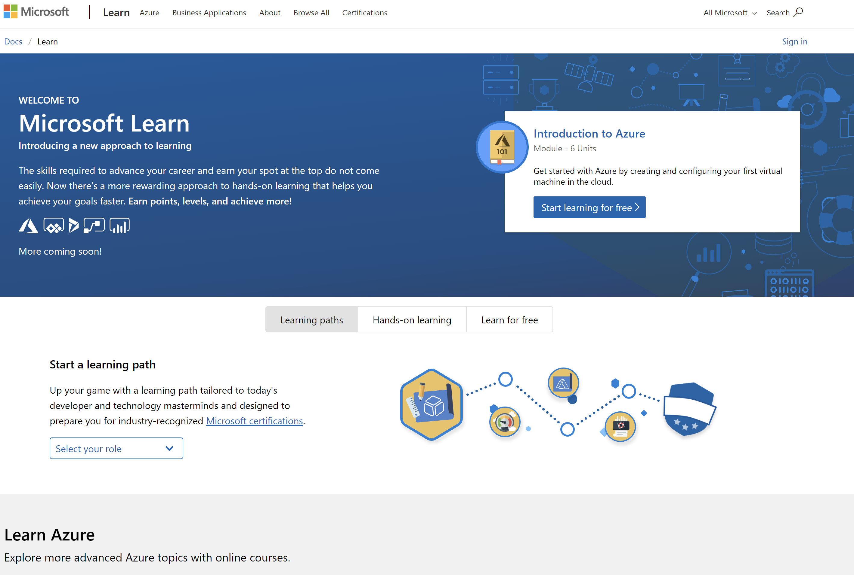
/MS Learn alert
Complete interactive learning exercises, watch videos, and practice and apply your new skills.
aka.ms/DATA30MSLearnCollection
Notes:
https://aka.ms/DATA30MSLearnCollection
Up to 256 vcores at the moment

Slide 23


Get Certified
Resources
Session Resources
aka.ms/DATA30
Session Code on GitHub
aka.ms/DATA30repo
All Event Resources
aka.ms/mymsignitethetour
aka.ms/azuredataengineer
#MSIgniteTheTour
Notes:
TALKING POINTS
As mentioned at the beginning of the session, we bundled all resources to this session
This Learning Path provides a step towards pursuing the Microsoft Certified: Azure Data Engineer Associate level certification.
The link to this certification, and the skills being measured on the certification exams associated with this role-based certifications are available for you here.

Slide 24
Transforming and enriching data
Speaker name
Title

